Slide 1
LAMBRUK
SOLAR PROJECT

Slide 2
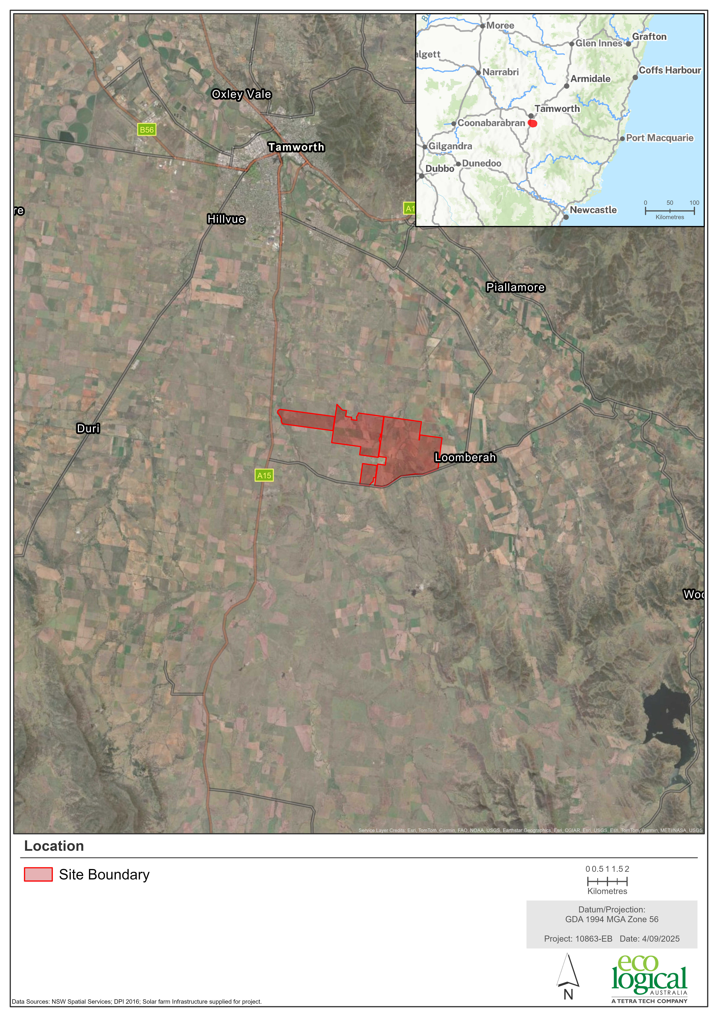
KEY PROJECT FEATURES
Photovoltaic (PV) development with a capacity of up to 500 MW DC
300 MW AC / 1,200 megawatt-hour (MWh) de-centralised Battery Energy Storage System (BESS)
Connection to the existing Transgrid 330 kilovolt (kV) overhead transmission line
New collector substation

Slide 3
UPDATED PROJECT LAYOUT

Slide 4

Landscape and Visual
Visual Impact Ratings on dwellings (Detailed Assessment only):
Within 1 km of the Project Site – 1 receptor has a Moderate impact rating (prior to mitigation) with 17 occupied cells, 28 receptors have a Low impact rating (prior to mitigation) ranging from one to 14 occupied cells; three have a Nil impact rating.
1 km to 2.5 km from the Project Site - 14 receptors have a Low impact rating (prior to mitigation) ranging from two to seven occupied cells; seven have a Nil impact rating (prior to mitigation).
Visual Impact Ratings on Public Viewpoints:
Eight assessed with Detailed Assessment, four are rated as having a Low impact rating, three are rated as having a Very Low impact rating and one is rated as a having a Nil impact rating (prior to mitigation).
No glint and glare impacts upon receptors and any identified impacts upon the local road network will be mitigated via landscape screening.
Mitigation Summary:
Landscape screening around the Project Site to further reduce visual amenity impacts.
Preparation and implementation of a Landscape Management Plan post-approval.

Slide 5
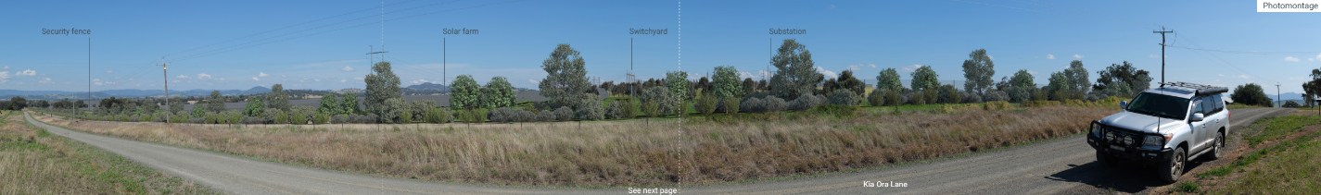
Public Viewpoint Photomontages
Kia Ora Lane (VPA04) – prior to mitigation
Kia Ora Lane (VPA04) – with mitigation

Slide 6
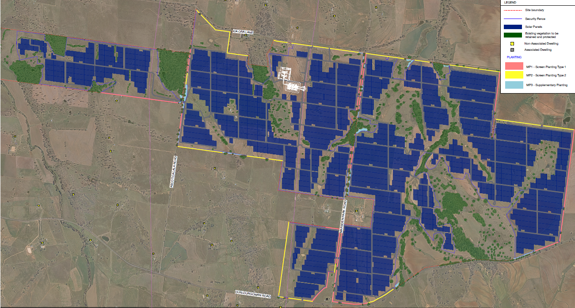
Landscape and Visual

Slide 7
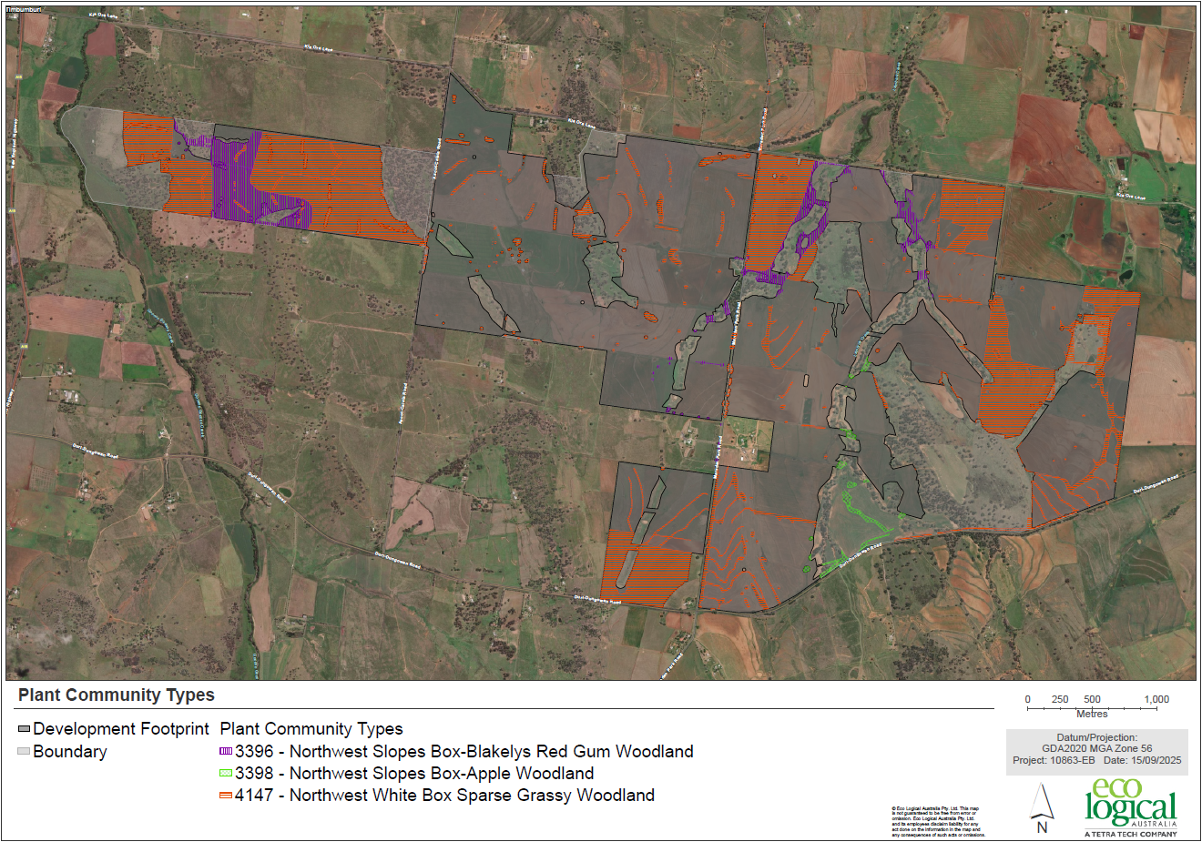
Biodiversity
Direct impacts (clearing or tree pruning/branch lopping) upon Native Vegetation that will require offsets include:
Good Condition Grassy Woodland– approximately 1.44 ha
Moderate Grassy Woodland Condition – approximately 6.75 ha
Poor Grassy Woodland Condition – approximately 0.03 ha
Grassland – approximately 0.02 ha
Planted – approximately 6.23 ha.
Represents a reduction of Good, Moderate, Poor and Planted impacts of approximately 41.3 ha relative to the Development Footprint proposed in the Scoping Report.
No threatened flora species have been identified within the Project Site.
Mitigation Summary:
Detailed design and micro-siting of infrastructure may result in a further reduction of impacts upon Native Vegetation.
Preparation and implementation of Biodiversity Management Plan and Biodiversity Offset Strategy.

Slide 8
Aboriginal Heritage
Field Surveys and Test Excavations were completed within the Project Site, and the results are presented below:
Field Survey:
Twenty-four previously unrecorded Aboriginal sites were identified during the survey, including eight isolated finds and 16 low density artefact scatters.
One previously recorded Aboriginal site was surveyed however no artefacts could be located at the site during the survey.
Survey identified 13 locations with potential to contain subsurface deposits, namely along named waterways.
Test excavation:
110 test pits measuring 50cm by 50 cm were excavated across the areas considered to have potential for subsurface deposits.
A total of 13 artefacts were recovered during the test excavation program.
Test excavation resulted in three additional sites (all isolated finds) being recorded and two surface artefact scatters were confirmed to be associated with low density subsurface deposits.

Slide 9

Historic Heritage
State and Local Heritage Items were considered as part of the Historic Heritage Assessment. The search identified the key items listed below:
A search of the Tamworth Regional LEP 2010 returned two records for historical heritage items within 1.5km to the project: I508 (Timbumburi School), located 825m away, and I157 (Loomberah War Memorial Hall), located 1.4km away.
Background research identified two areas with archaeological potential associated with the former locations of the Ferntop Provisional School and Ferntop Union Church. No evidence of the former locations could be identified during the survey.
Seven items with potential to have heritage values were identified across the Survey Area. Items include rural infrastructure, a former dwelling and a survey tree.

Slide 10
Aboriginal and Historic Heritage
The Development Footprint has been designed to avoid all recorded Aboriginal sites. All Aboriginal sites within 80m of the project infrastructure will be fenced to ensure they are not inadvertently harmed.
None of the seven items with potential to have heritage values were assessed as having local or state significance. Three of these items (farm sheds and livestock yards) will be impacted by the project.
The assessment has concluded that the two locally listed items will not be directly or indirectly impacted by the project.
The former locations of the Ferntop Provisional School and the Ferntop Union Church will be avoided by the project.

Slide 11
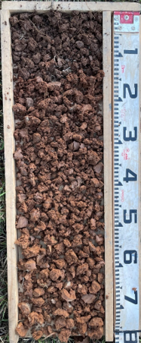
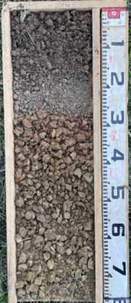
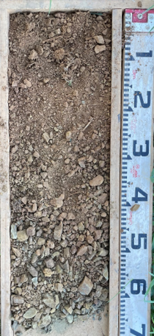
Soils and Agriculture
Agricultural Impact
The land use across the Project Site is predominately :
Livestock grazing on modified pastures
Fodder crops
Agricultural Land Value:
No trigger mapped Biophysical Strategic Agricultural Land (BSAL) in Disturbance Footprint
Department of Primary Industries and Regional Development value of 1,144ha is $392,758/year
LGA value of 1,144ha is $ 475,651/year
Mitigation Summary:
Preparation of Agrisolar Strategy incorporating:
Grazing
Soil improvement
Opportunities for farmers to lease land
Preparation of Biosecurity Management Plan
Soils
The Project Site consists of the following soil types:
1. Dermosols – 804ha
2. Chromosols – 317ha
3. Tenosols – 23ha
Mitigation:
Permanent groundcover to reduce erosion
Preparation of Soil and Erosion Management Plan during construction
Preparation of Rehabilitation and Decommissioning Management Plan
1 2 3

Slide 12
Soils and Agriculture
Soil Survey / Land and Soil Capability Verification
Soil survey, identifying soil units, soil qualities and risks including erosion, acid sulfate soils (ASS) risk and salinity.
Land and soil capability (LSC) verification.
LSC verification included comparison of soils against a Hazard Criteria to determine the Class. Hazard criteria includes water erosion, wind erosion, structure, acidity, salinity, water-logging, soil depth and movement.
Soil survey was undertaken at a 1:25,000 survey intensity (1 site for every 25 ha = 50 sites).
Soil samples were collected at each of the assessment site’s soil horizons to a depth of 1 m, with a total of 128 samples collected.
A representative number of samples collected (42 samples) were laboratory tested.
Soil profiles were assessed were assessed in accordance with the Australian Soil and Land Survey Field Handbook soil classification procedures.
Field Assessment Parameters included horizon depth, field texture grade, field colour (Munsell colour chart), pedality structure, grade and consistence, soil fabric and stickiness, stones (abundance and size), mottles (amount, size and distinctiveness), segregations (abundance, nature, form and size), pan presence and form, permeability and drainage, field pH, field moisture, surface condition, landform pattern/element, current land use and previous disturbance, and vegetation.
Laboratory analysis included pH, Electrical Conductivity and Chloride, Cation Exchange Capacity, Particle Size Analysis, and Emerson Aggregate Test.

Slide 13
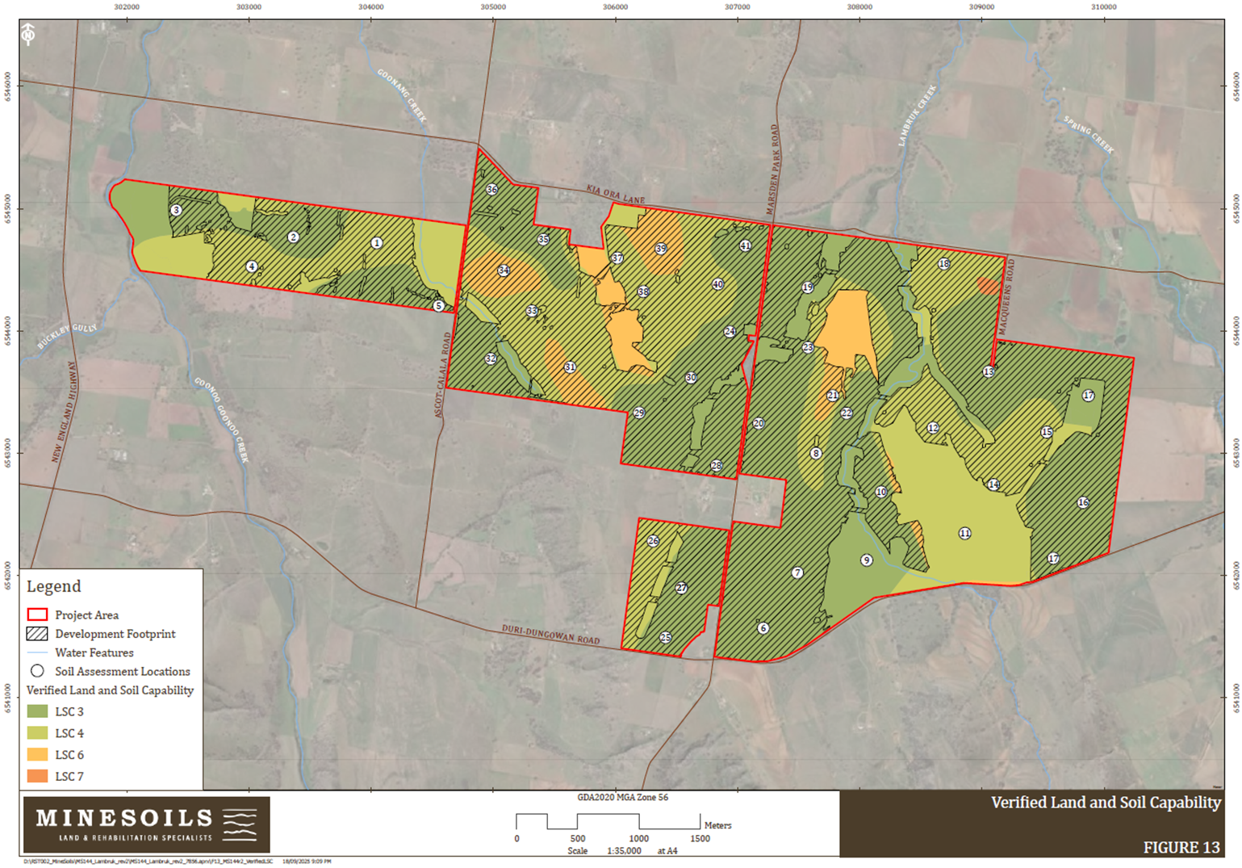
Land & Soil Capability
LSC 3 Moderately High Capability – 715ha
LSC 4 Moderate Capability – 317ha
LSC 6 Low Capability – 62ha
LSC 7 Very Low Capability – 2ha

Slide 14
Noise and Vibration
Construction Noise:
Noise monitoring surveys were conducted at two locations in August 2024 (Kia Ora Lane near the New England Highway and Marsden Park Road). The data gathered assisted in establishing the background noise levels at the Project Site.
There are 111 sensitive receivers situated within 3km of the Project Site:
The noise impact levels during the construction phase:
63 receivers maximum noise level of less than 25dB
36 receivers maximum noise level between 25dB and 35dB
12 receivers maximum noise level between 35dB and 45dB
Noise exceedances are predicted at 10 receptors surrounding the Project (prior to mitigation) during the construction phase. With mitigation measures implemented, construction noise will not exceed applicable thresholds at any receptor. A Noise Management Plan will be prepared post-approval.
Operational Noise:
There are no predicted noise exceedances at any receptors during the operational phase of the Project.
The figure on the following slide shows where noise levels would drop below the required 35dB in green and is based on the location of the Substation and the BESS units.
Construction Noise Management Levels
Receiver Type | Assessment Period | Adopted RBL dB LA90 | NML dB LAeq(15min)
Rural Residential | Standard Hours | 35 | 45 (RBL+10dBA)
Highly Noise Affected | Standard Hours | n/a | 75
Educational | When in use | N/A | 45 (internal) 55 (external)²
Project Noise Trigger Levels
Catchment | Assessment Period¹ | PINL dB LAeq(15min) | PANL dB LAeq(15min) | PNTL dB LAeq(15min)
Residential Receivers (Rural) | Day | 40 | 53 | 40
 | Evening | 35 | 48 | 35
 | Night | 35 | 43 | 35
Educational | When in use | -- | 38 (internal 1 hr) 48 (external 1 hr)⁴ | 38 (internal 1 hr) 48 (external 1 hr)⁴

Slide 15
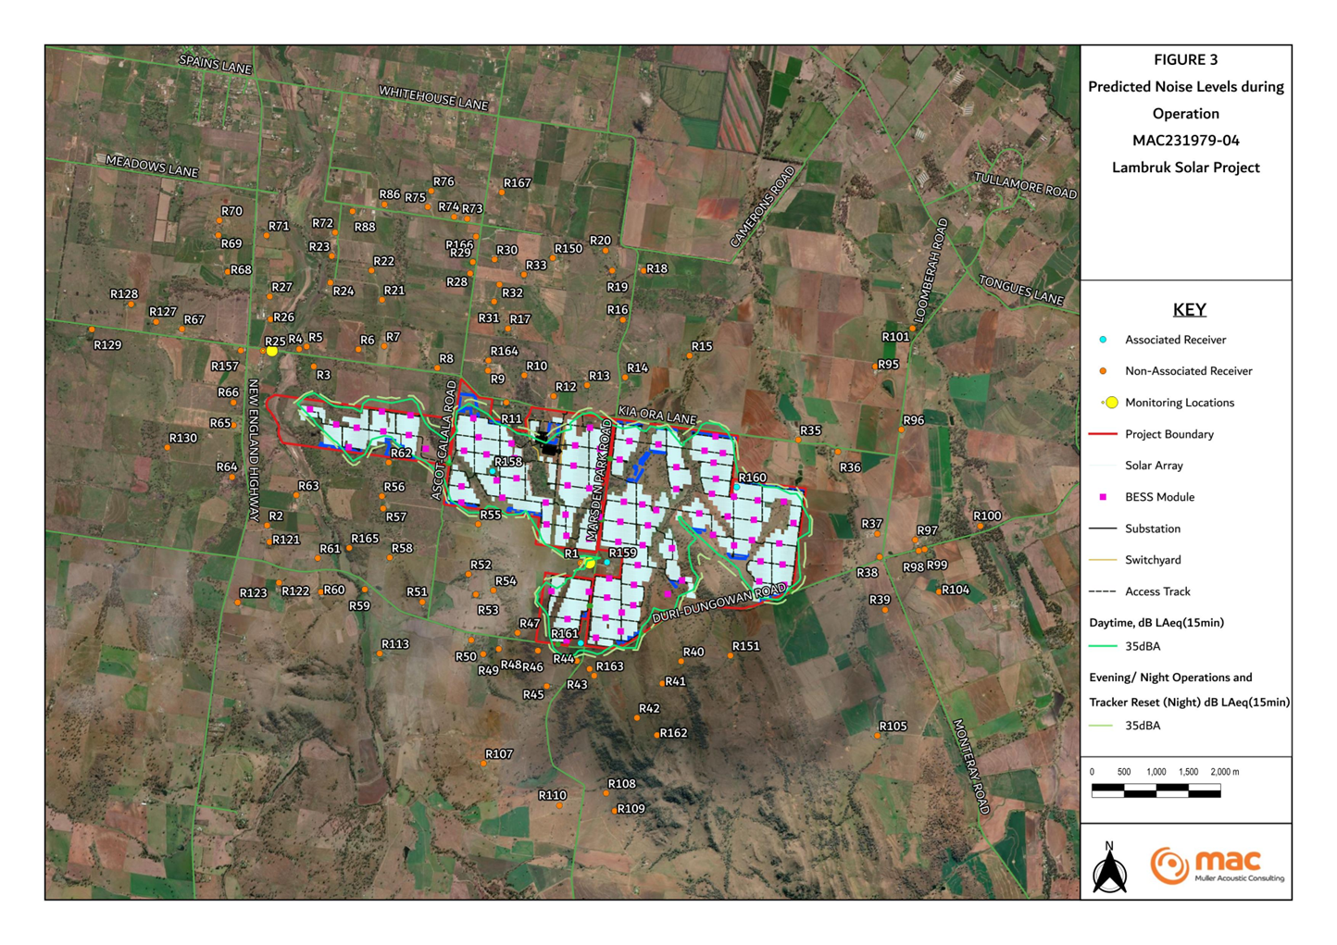

Slide 16
Hydrology
Flood modelling was developed for 5% and 1% AEP flood events, and the Probable Maximum Flood (PMF) events.
Results indicate that predicted flooding increases within the Project Site associated with the Project infrastructure are typically minor and with appropriate design and erosion controls present, erosion or inundation risks are considered to be negligible.
Water quality risks include soil erosion and sedimentation, spill of hydrocarbons or other chemicals associated with general vehicle usage, construction activities and maintenance, release of concrete by-products (dust, slurry, water), and discharge/spill of wastewater.
Water quality risks will be managed via relevant mitigation measures and are considered negligible.
Water demands during construction and operational phases of the Project will be met via either Water Access Licenses (WAL) or harvestable run-off from farm dams.
Mitigation Summary
Preparation and implementation of an Erosion and Sediment Control Plan, post-approval.
Preparation and implementation of a Water Quality Monitoring Plan, post approval.

Slide 17
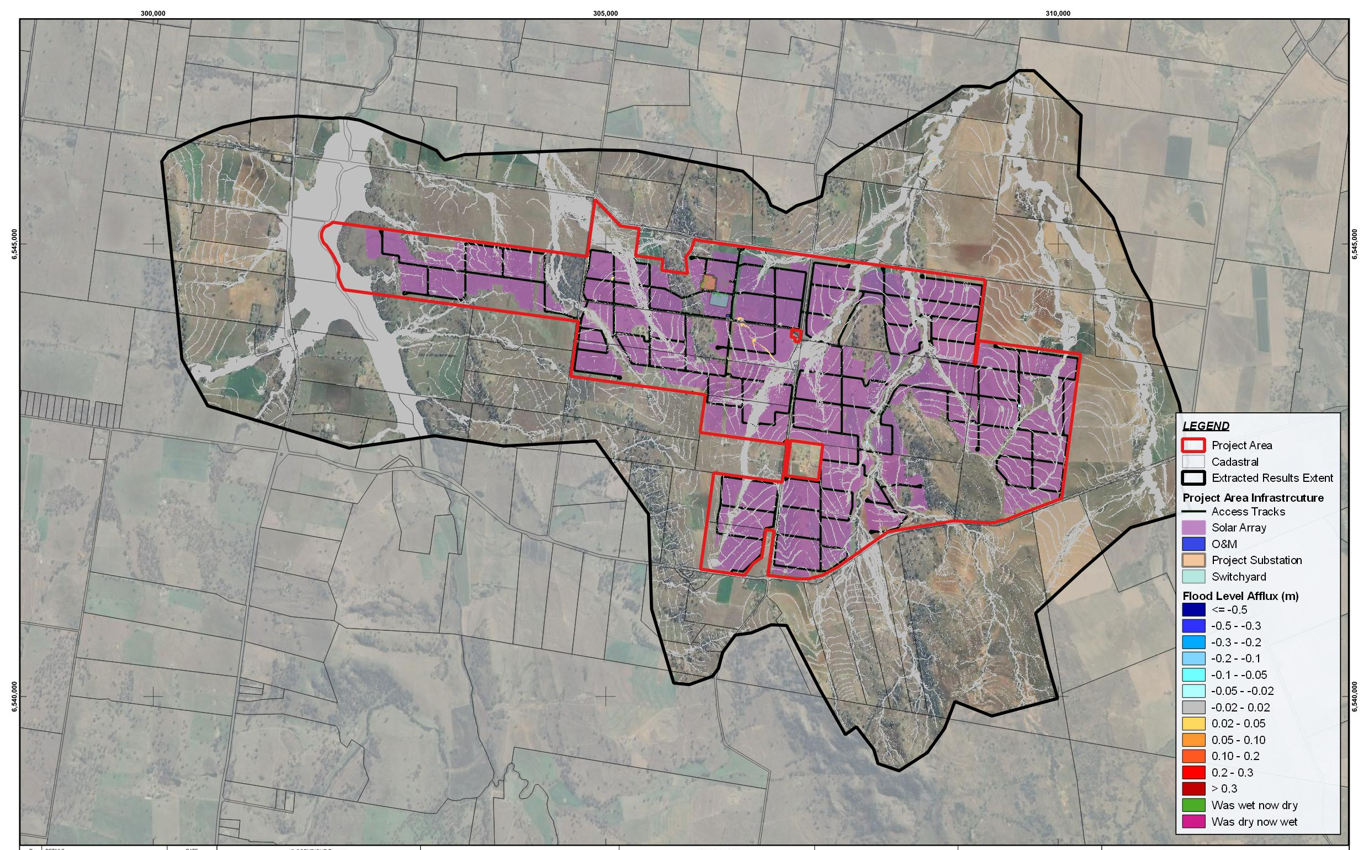
Hydrology – Changes in 1% AEP Depths

Slide 18


LAMBRUK SOLAR PROJECT
CONTACT US
lambruksolarproject.com.au 0485 840 493

